Slide 1

CSC334 - Parallel & Distributed Computing
Chapter 3: Processes
Mr. Aoun Haider, Ms. Muntaha Amjad

Slide 2
Processes
Threads
Introduction to threads
Basic idea
We build virtual processors in software, on top of physical processors:
Processor: Provides a set of instructions along with the capability of automatically executing a series of those instructions.
Thread: A minimal software processor in whose context a series of instructions can be executed. Saving a thread context implies stopping the current execution and saving all the data needed to continue the execution at a later stage.
Process: A software processor in whose context one or more threads may be executed. Executing a thread, means executing a series of instructions in the context of that thread.
Introduction to threads

Slide 3
Processes
Threads
Context switching
Contexts
Processor context: The minimal collection of values stored in the registers of a processor used for the execution of a series of instructions (e.g., stack pointer, addressing registers, program counter).
Introduction to threads

Slide 4
Processes
Threads
Context switching
Contexts
Processor context: The minimal collection of values stored in the registers of a processor used for the execution of a series of instructions (e.g., stack pointer, addressing registers, program counter).
Thread context: The minimal collection of values stored in registers and memory, used for the execution of a series of instructions (i.e., processor context, state).
Introduction to threads

Slide 5
Processes
Threads
Context switching
Contexts
Processor context: The minimal collection of values stored in the registers of a processor used for the execution of a series of instructions (e.g., stack pointer, addressing registers, program counter).
Thread context: The minimal collection of values stored in registers and memory, used for the execution of a series of instructions (i.e., processor context, state).
Process context: The minimal collection of values stored in registers and memory, used for the execution of a thread (i.e., thread context, but now also at least MMU register values).
Introduction to threads

Slide 6
Processes
Threads
Context switching
Observations
Threads share the same address space. Thread context switching can be done entirely independent of the operating system.
Process switching is generally (somewhat) more expensive as it involves getting the OS in the loop, i.e., trapping to the kernel.
Creating and destroying threads is much cheaper than doing so for processes.
Introduction to threads

Slide 7
Processes
Threads
Why use threads
Some simple reasons
Avoid needless blocking: a single-threaded process will block when doing I/O; in a multithreaded process, the operating system can switch the CPU to another thread in that process.
Exploit parallelism: the threads in a multithreaded process can be scheduled to run in parallel on a multiprocessor or multicore processor.
Avoid process switching: structure large applications not as a collection of processes, but through multiple threads.
Introduction to threads

Slide 8
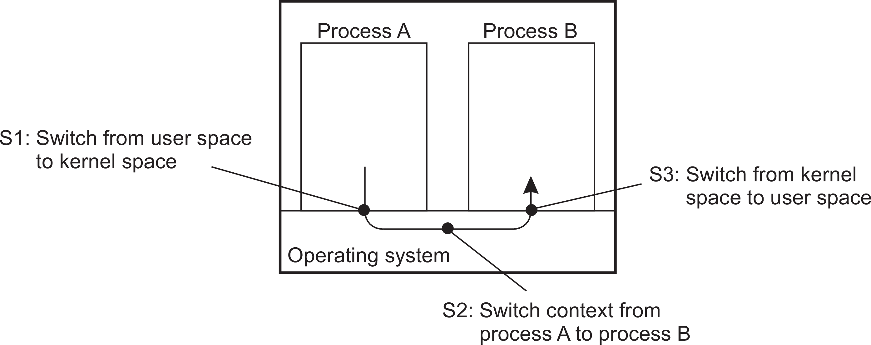
Processes
Threads
Avoid process switching
Avoid expensive context switching
Trade-offs
Threads use the same address space: more prone to errors
No support from OS/HW to protect threads using each other’s memory
Thread context switching may be faster than process context switching
Introduction to threads

Slide 9
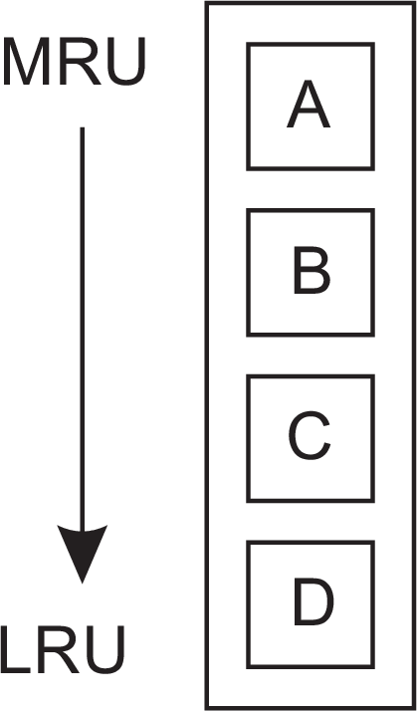


Processes
Threads
The cost of a context switch
Consider a simple clock-interrupt handler
direct costs: actual switch and executing code of the handler
indirect costs: other costs, notably caused by messing up the cache
What a context switch may cause: indirect costs
before the context switch
after the context switch
after accessing block D.
(a)
(b)
(c)
Introduction to threads

Slide 10
Processes
Threads
A simple example in Python
1 from multiprocessing import Process
2 from time import *
3 from random import *
4
5 def sleeper(name):
6 t = gmtime()
7 s = randint(1,20)
8 txt = str(t.tm_min)+’:’+str(t.tm_sec)+’ ’+name+’ is going to sleep for ’+str(s)+’ seconds’
9 print(txt)
10 sleep(s)
11 t = gmtime()
12 txt = str(t.tm_min)+’:’+str(t.tm_sec)+’ ’+name+’ has woken up’
13 print(txt)
14
15 if name == ’ main ’:
16 p = Process(target=sleeper, args=(’eve’,))
17 q = Process(target=sleeper, args=(’bob’,))
18 p.start(); q.start()
19 p.join(); q.join()
40:23 eve is going to sleep for 14 seconds 40:23 bob is going to sleep for 4 seconds 40:27 bob has woken up
40:37 eve has woken up
Introduction to threads

Slide 11
Processes
Threads
A simple example in Python
1 from multiprocessing import Process
2 from threading import Thread
3
4 shared_x = randint(10,99)
5
6 def sleeping(name):
7
8
9
10
11
12
13
14
global shared_x
t = gmtime(); s = randint(1,20)
txt = str(t.tm_min)+’:’+str(t.tm_sec)+’ ’+name+’ is going to sleep for ’+str(s)+’ seconds’
print(txt) sleep(s)
t = gmtime(); shared_x = shared_x + 1
txt = str(t.tm_min)+’:’+str(t.tm_sec)+’ ’+name+’ has woken up, seeing shared x being ’
print(txt+str(shared_x) )
15
16 def sleeper(name):
17
18
19
20
21
22
23
24
25
sleeplist = list()
print(name, ’sees shared x being’, shared_x)
for i in range(3):
subsleeper = Thread(target=sleeping, args=(name+’ ’+str(i),)) sleeplist.append(subsleeper)
for s in sleeplist: s.start(); for s in sleeplist: s.join()
print(name, ’sees shared x being’, shared_x)
26 if name == ’ main ’:
27 p = Process(target=sleeper, args=(’eve’,))
28 q = Process(target=sleeper, args=(’bob’,))
29 p.start(); q.start()
30 p.join(); q.join()
Introduction to threads

Slide 12
Processes
Threads
A simple example in Python
eve sees shared x being 71
53:21 eve 0 is going to sleep for 20 seconds bob sees shared x being 84
53:21 eve 1 is going to sleep for 15 seconds 53:21 eve 2 is going to sleep for 3 seconds 53:21 bob 0 is going to sleep for 8 seconds 53:21 bob 1 is going to sleep for 16 seconds 53:21 bob 2 is going to sleep for 8 seconds
53:24 eve 2 has woken up, seeing shared x being 72 53:29 bob 0 has woken up, seeing shared x being 85 53:29 bob 2 has woken up, seeing shared x being 86 53:36 eve 1 has woken up, seeing shared x being 73 53:37 bob 1 has woken up, seeing shared x being 87 bob sees shared x being 87
53:41 eve 0 has woken up, seeing shared x being 74 eve sees shared x being 74
Introduction to threads

Slide 13
Processes
Threads
Threads and operating systems
Main issue
Should an OS kernel provide threads, or should they be implemented as user-level packages?
User-space solution
All operations can be completely handled within a single process ⇒
implementations can be extremely efficient.
All services provided by the kernel are done on behalf of the process in which a thread resides ⇒ if the kernel decides to block a thread, the entire process will be blocked.
Threads are used when there are many external events: threads block on a per-event basis ⇒ if the kernel can’t distinguish threads, how can it support signaling events to them?
Introduction to threads

Slide 14
Processes
Threads
Threads and operating systems
Kernel solution
The whole idea is to have the kernel contain the implementation of a thread package. This means that all operations return as system calls:
Operations that block a thread are no longer a problem: the kernel schedules another available thread within the same process.
handling external events is simple: the kernel (which catches all events) schedules the thread associated with the event.
The problem is (or used to be) the loss of efficiency because each thread operation requires a trap to the kernel.
Conclusion – but
Try to mix user-level and kernel-level threads into a single concept, however, performance gain has not turned out to generally outweigh the increased complexity.
Introduction to threads

Slide 15
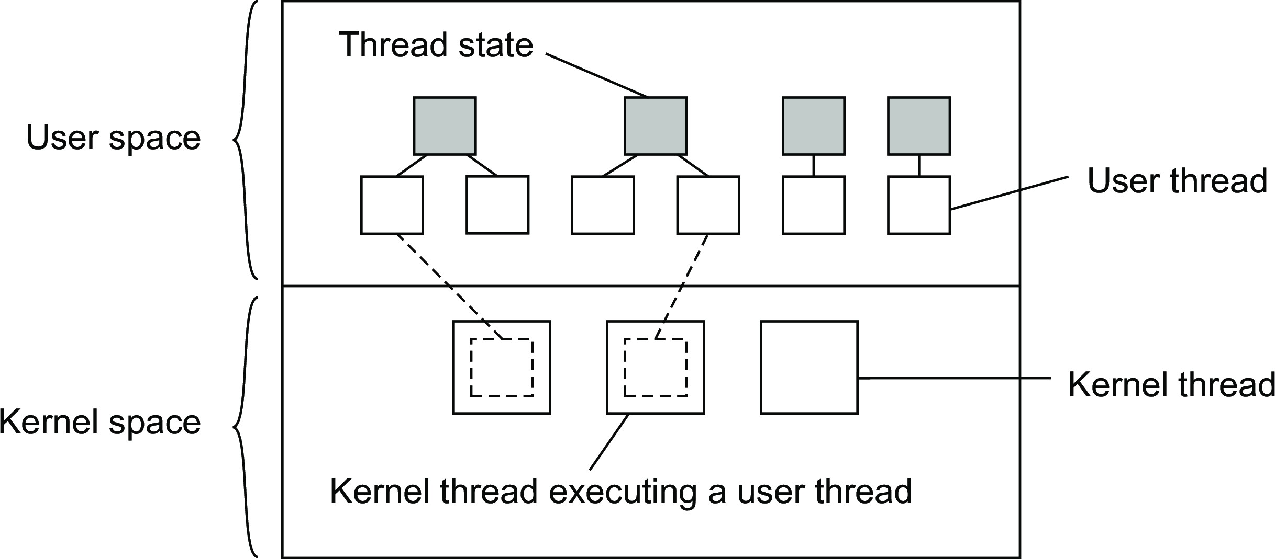
Processes
Threads
Combining user-level and kernel-level threads
Basic idea
Introduce a two-level threading approach: kernel threads that can execute user-level threads.
Introduction to threads

Slide 16
Processes
Threads
User and kernel threads combined
Principle operation
Introduction to threads

Slide 17
Processes
Threads
User and kernel threads combined
Principle operation
User thread does system call ⇒ the kernel thread that is executing that user thread, blocks. The user thread remains bound to the kernel thread.
Introduction to threads

Slide 18
Processes
Threads
User and kernel threads combined
Principle operation
User thread does system call ⇒ the kernel thread that is executing that user thread, blocks. The user thread remains bound to the kernel thread.
The kernel can schedule another kernel thread having a runnable user thread bound to it. Note: this user thread can switch to any other runnable user thread currently in user space.
Introduction to threads

Slide 19
Processes
Threads
User and kernel threads combined
Principle operation
User thread does system call ⇒ the kernel thread that is executing that user thread, blocks. The user thread remains bound to the kernel thread.
The kernel can schedule another kernel thread having a runnable user thread bound to it. Note: this user thread can switch to any other runnable user thread currently in user space.
A user thread calls a blocking user-level operation ⇒ do context switch to a runnable user thread, (then bound to the same kernel thread).
Introduction to threads

Slide 20
Processes
Threads
User and kernel threads combined
Principle operation
User thread does system call ⇒ the kernel thread that is executing that user thread, blocks. The user thread remains bound to the kernel thread.
The kernel can schedule another kernel thread having a runnable user thread bound to it. Note: this user thread can switch to any other runnable user thread currently in user space.
A user thread calls a blocking user-level operation ⇒ do context switch to a runnable user thread, (then bound to the same kernel thread).
When there are no user threads to schedule, a kernel thread may remain idle, and may even be removed (destroyed) by the kernel.
Introduction to threads

Slide 21
Processes
Threads
Using threads at the client side
Multithreaded web client
Hiding network latencies:
Web browser scans an incoming HTML page, and finds that more files need to be fetched.
Each file is fetched by a separate thread, each doing a (blocking) HTTP request.
As files come in, the browser displays them.
Multiple request-response calls to other machines (RPC)
A client does several calls at the same time, each one by a different thread.
It then waits until all results have been returned.
Note: if calls are to different servers, we may have a linear speed-up.
Threads in distributed systems

Slide 22
Processes
Threads
Multithreaded clients: does it help?
Thread-level parallelism: TLP
Let c_{i} denote the fraction of time that exactly i threads are being executed simultaneously.
∑N
i · c_{i}
TLP =
i =1
1 −c₀
with N the maximum number of threads that (can) execute at the same time.
Threads in distributed systems

Slide 23
Processes
Threads
Multithreaded clients: does it help?
Thread-level parallelism: TLP
Let c_{i} denote the fraction of time that exactly i threads are being executed simultaneously.
∑N
i · c_{i}
TLP =
i =1
1 −c₀
with N the maximum number of threads that (can) execute at the same time.
Practical measurements
A typical Web browser has a TLP value between 1.5 and 2.5 ⇒ threads are primarily used for logically organizing browsers.
Threads in distributed systems

Slide 24
Processes
Threads
Using threads at the server side
Improve performance
Starting a thread is cheaper than starting a new process.
Having a single-threaded server prohibits simple scale-up to a multiprocessor system.
As with clients: hide network latency by reacting to next request while previous one is being replied.
Better structure
Most servers have high I/O demands. Using simple, well-understood blocking calls simplifies the structure.
Multithreaded programs tend to be smaller and easier to understand due to simplified flow of control.
Threads in distributed systems

Slide 25
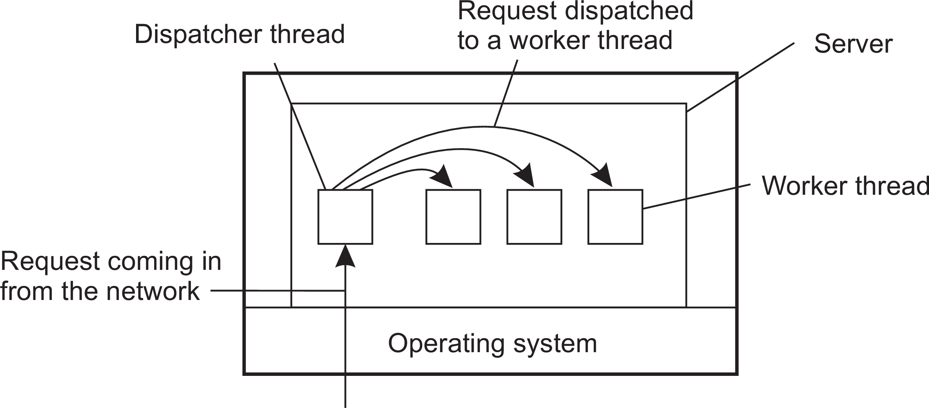
Processes
Threads
Why multithreading is popular: organization
Dispatcher/worker model
Overview
Model | Characteristics
Multithreading | Parallelism, blocking system calls
Single-threaded process | No parallelism, blocking system calls
Finite-state machine | Parallelism, nonblocking system calls
Threads in distributed systems

Slide 26
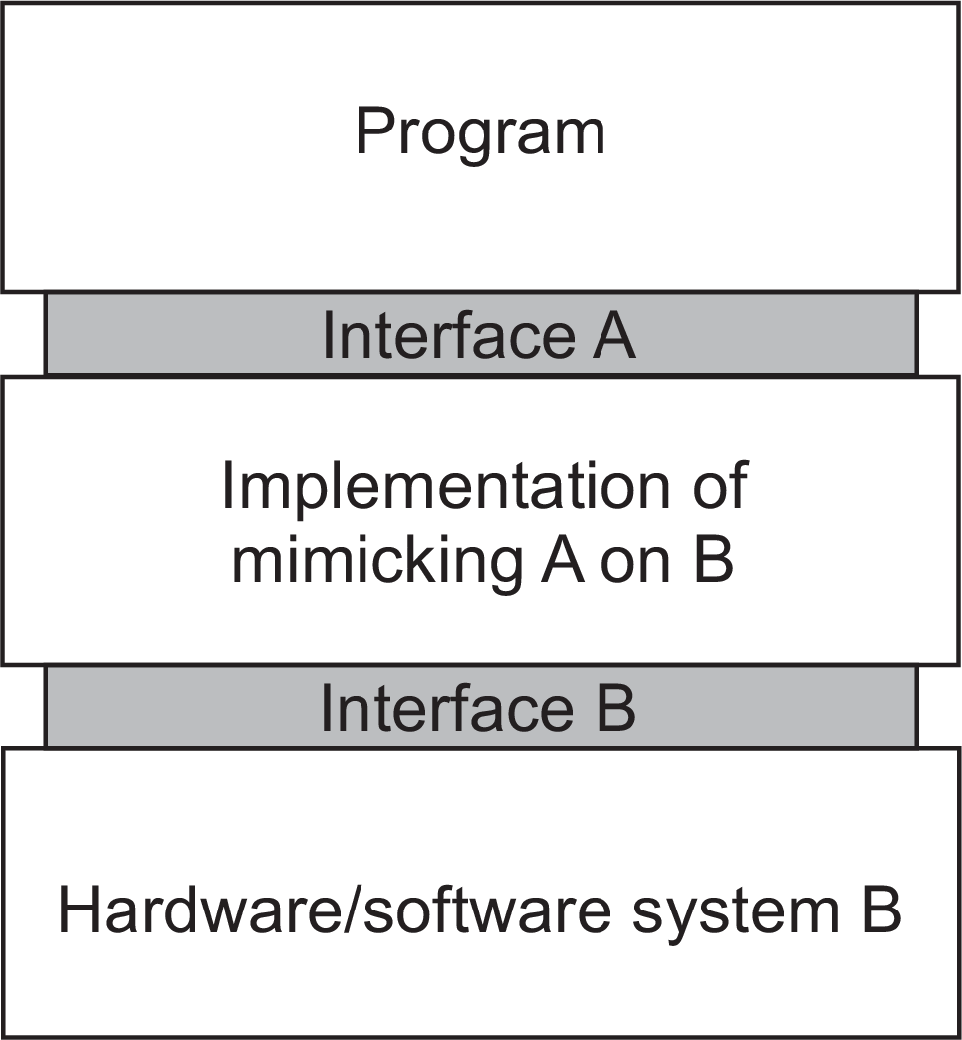
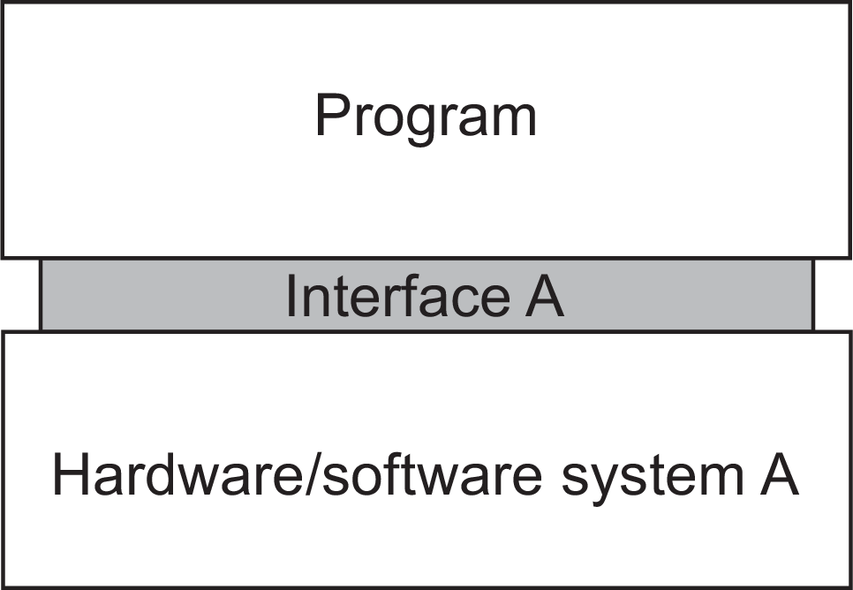
Processes
Virtualization
Virtualization
Observation
Virtualization is important:
Hardware changes faster than software
Ease of portability and code migration
Isolation of failing or attacked components
Principle: mimicking interfaces
Principle of virtualization

Slide 27
Mimicking interfaces
Processes Virtualization
Four types of interfaces at three different levels
Instruction set architecture: the set of machine instructions, with two subsets:
Privileged instructions: allowed to be executed only by the operating system.
General instructions: can be executed by any program.
System calls as offered by an operating system.
Library calls, known as an application programming interface (API)
Principle of virtualization

Slide 28
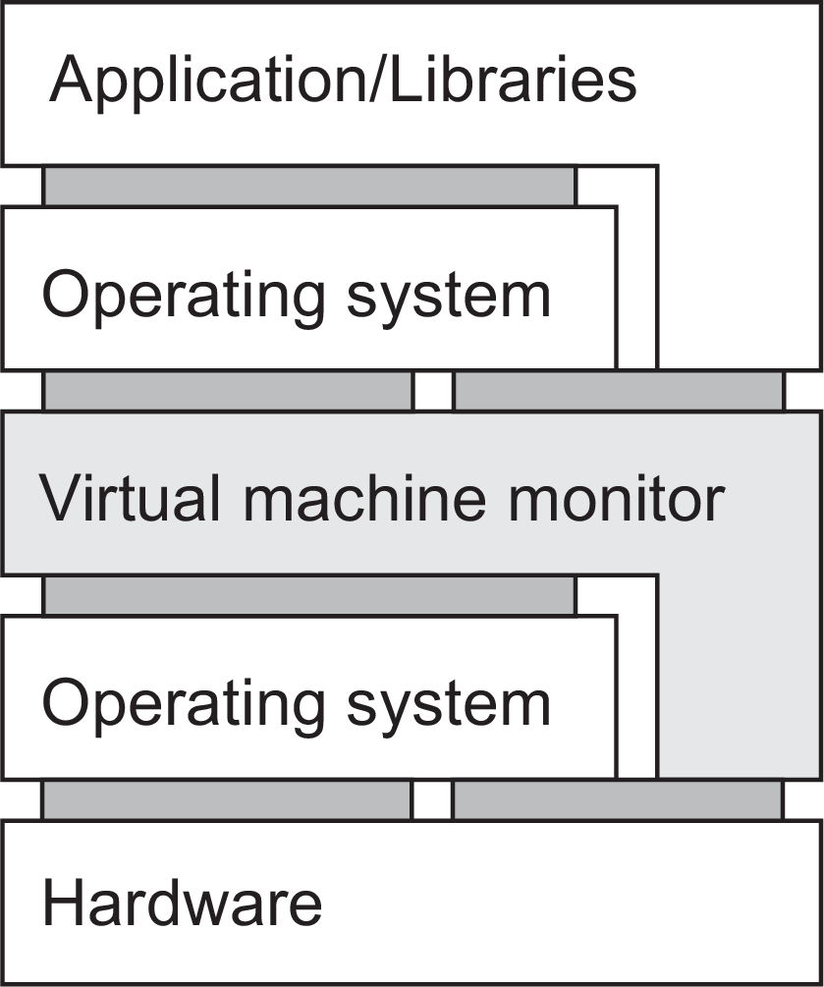
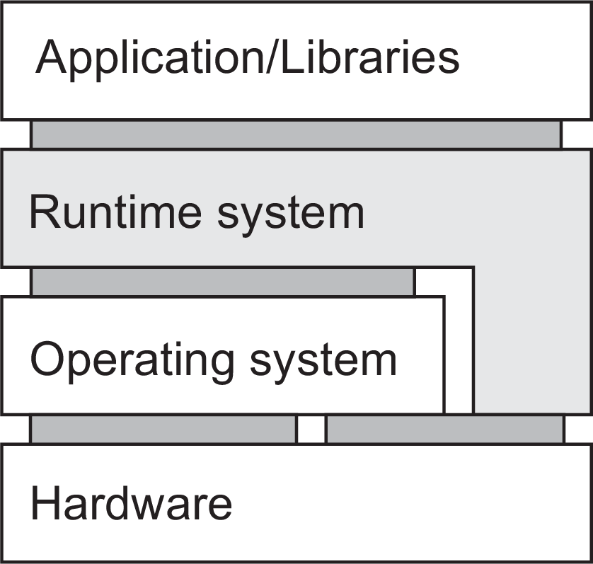
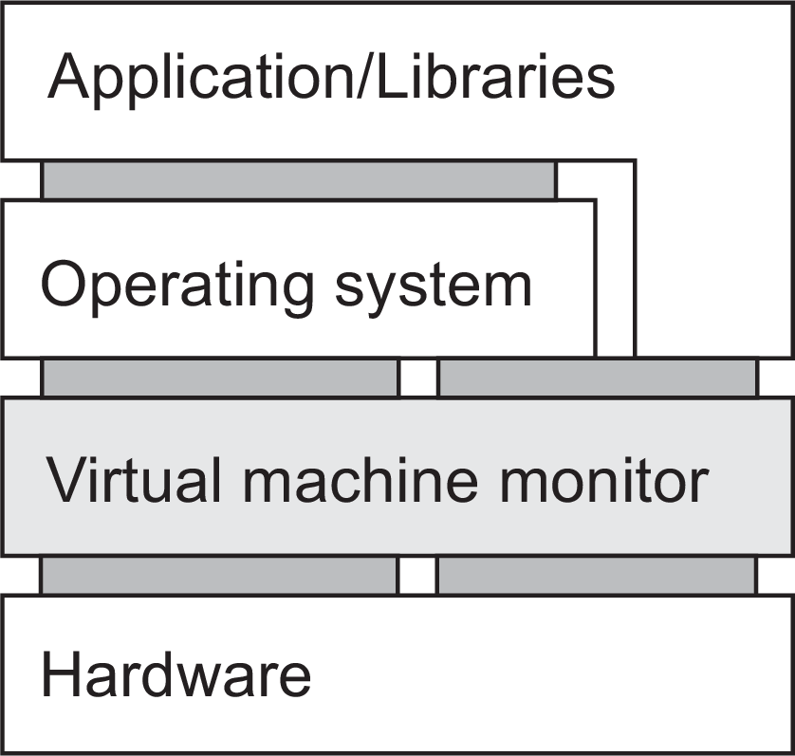
Processes
Virtualization
Ways of virtualization
(a) Process VM (b) Native VMM (c) Hosted VMM
Differences
Separate set of instructions, an interpreter/emulator, running atop an OS.
Low-level instructions, along with bare-bones minimal operating system
Low-level instructions, but delegating most work to a full-fledged OS.
Principle of virtualization

Slide 29
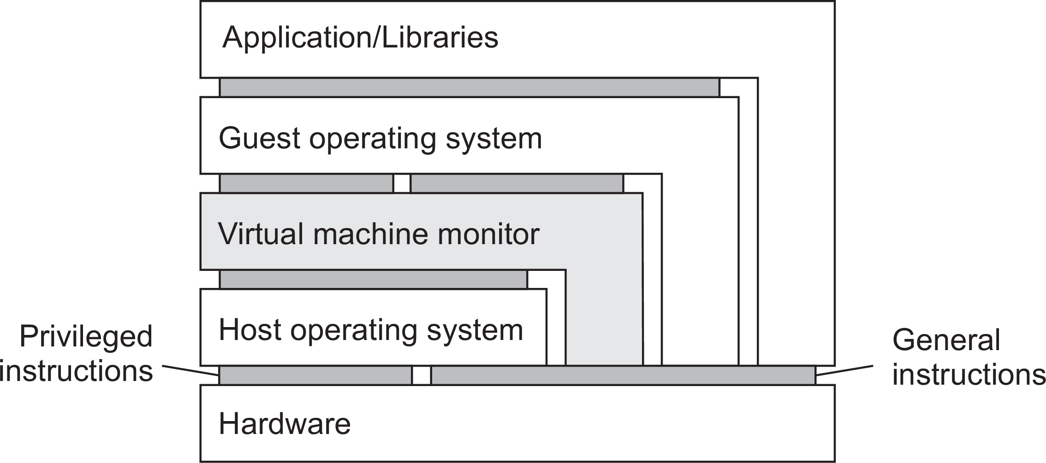
Processes
Virtualization
Zooming into VMs: performance
Refining the organization
Privileged instruction: if and only if executed in user mode, it causes a trap to the operating system
Nonpriviliged instruction: the rest
Special instructions
Control-sensitive instruction: may affect configuration of a machine (e.g., one affecting relocation register or interrupt table).
Behavior-sensitive instruction: effect is partially determined by context (e.g., POPF sets an interrupt-enabled flag, but only in system mode).
Principle of virtualization

Slide 30
Condition for virtualization
Processes Virtualization
Necessary condition
For any conventional computer, a virtual machine monitor may be constructed if the set of sensitive instructions for that computer is a subset of the set of privileged instructions.
Problem: condition is not always satisfied
There may be sensitive instructions that are executed in user mode without causing a trap to the operating system.
Solutions
Emulate all instructions
Wrap nonprivileged sensitive instructions to divert control to VMM
Paravirtualization: modify guest OS, either by preventing nonprivileged sensitive instructions, or making them nonsensitive (i.e., changing the context).
Principle of virtualization

Slide 31
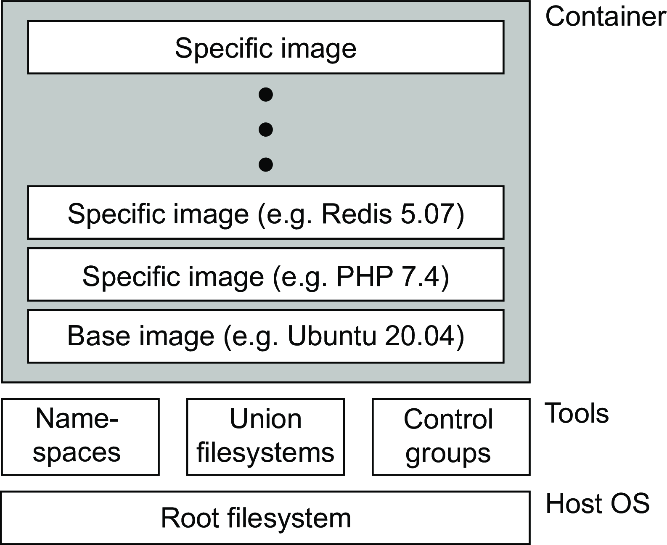
Processes
Virtualization
Containers
Namespaces: a collection of processes in a container is given their own view of identifiers
Union file system: combine several file systems into a layered fashion with only the highest layer allowing for write operations (and the one being part of a container).
Control groups: resource restrictions can be imposed upon a collection of processes.
Containers

Slide 32
Example: PlanetLab
Processes Virtualization
Essence
Different organizations contribute machines, which they subsequently share for various experiments.
Problem
We need to ensure that different distributed applications do not get into each other’s way ⇒ virtualization
It was developed for researchers to test and deploy their distributed applications.
Containers

Slide 33
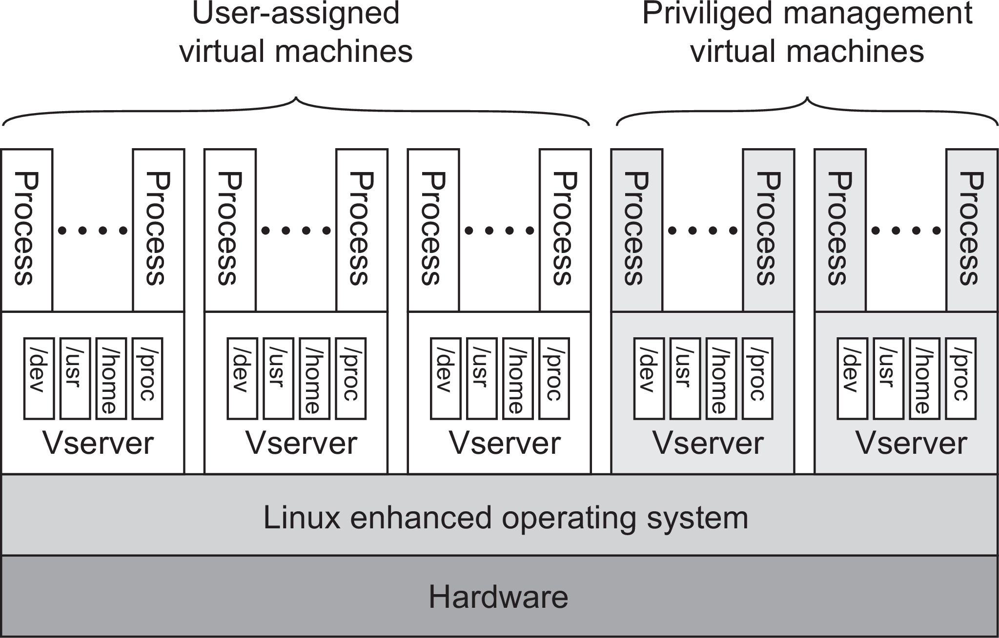
Processes
Virtualization
PlanetLab basic organization
Vserver
Independent and protected environment with its own libraries, server versions, and so on. Distributed applications are assigned a collection of vservers distributed across multiple machines
Containers

Slide 34
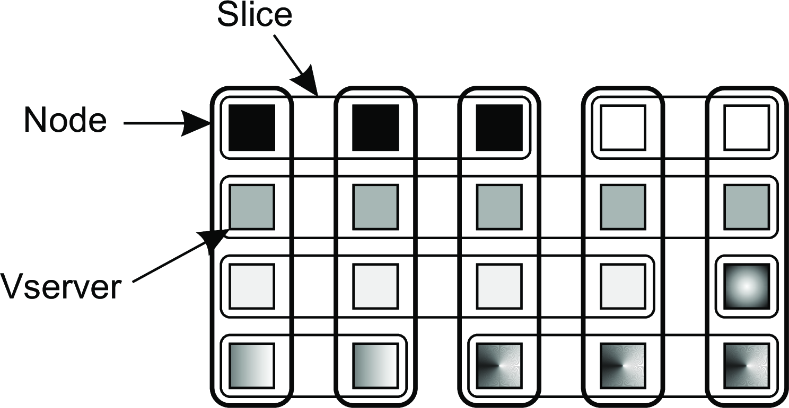
PlanetLab Vservers and slices
Processes Virtualization
Essence
Each Vserver operates in its own environment (cf. chroot).
Linux enhancements include proper adjustment of process IDs (e.g.,
init having ID 0).
Two processes in different Vservers may have same user ID, but does not imply the same user.
Separation leads to slices
Containers

Slide 35
Processes
Virtualization
VMs and cloud computing
Three types of cloud services
Infrastructure-as-a-Service covering the basic infrastructure
Platform-as-a-Service covering system-level services
Software-as-a-Service containing actual applications
IaaS
Instead of renting out a physical machine, a cloud provider will rent out a VM (or VMM) that may be sharing a physical machine with other customers ⇒ almost complete isolation between customers (although performance isolation may not be reached).
Application of virtual machines to distributed systems

Slide 36
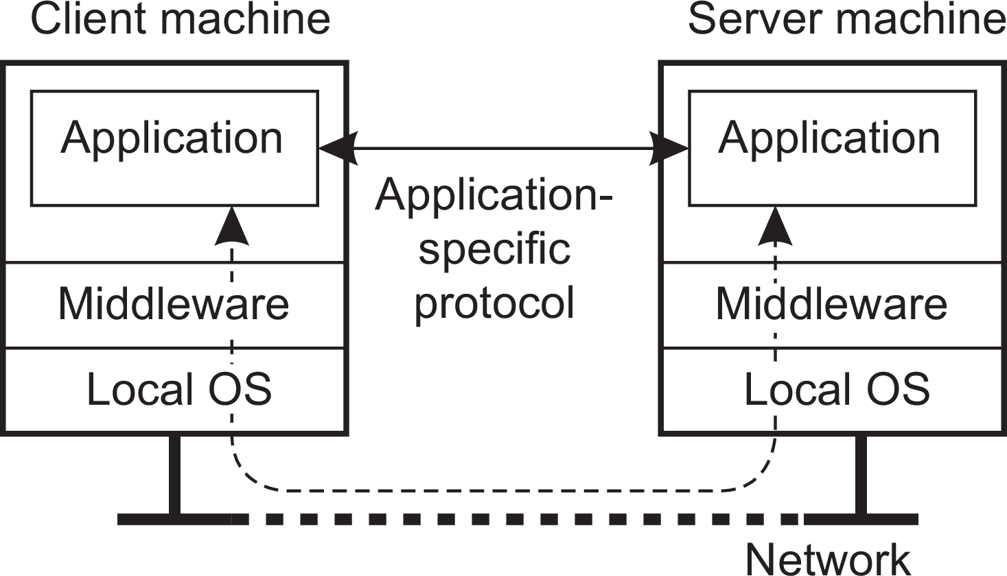
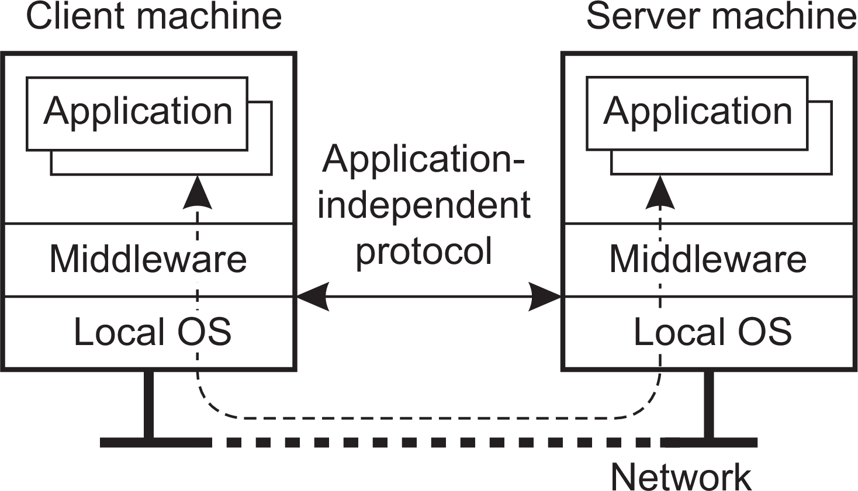
Processes
Clients
Client-server interaction
Distinguish application-level and middleware-level solutions
Networked user interfaces

Slide 37
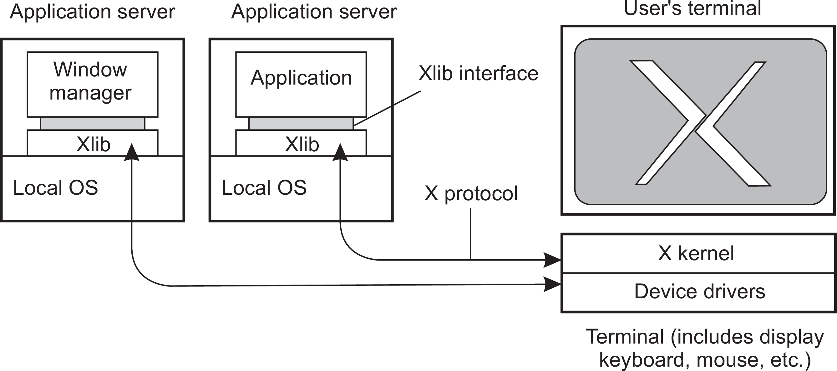
Processes
Clients
Example: The X Window system
Basic organization
Networked user interfaces

Slide 38
Processes
Clients
Example: The X Window system
Basic organization
X client and server
The application acts as a client to the X-kernel, the latter running as a server on the client’s machine.
Networked user interfaces

Slide 39
Processes
Clients
Improving X
Practical observations
There is often no clear separation between application logic and user-interface commands
Applications tend to operate in a tightly synchronous manner with an X kernel
Alternative approaches
Let applications control the display completely, up to the pixel level (e.g., VNC)
Provide only a few high-level display operations (dependent on local video drivers), allowing more efficient display operations.
Networked user interfaces

Slide 40
Processes
Clients
Virtual desktop environment
Logical development
With an increasing number of cloud-based applications, the question is how to use those applications from a user’s premise?
Issue: develop the ultimate networked user interface
Answer: use a Web browser to establish a seamless experience
The Google Chromebook
Virtual desktop environment

Slide 41
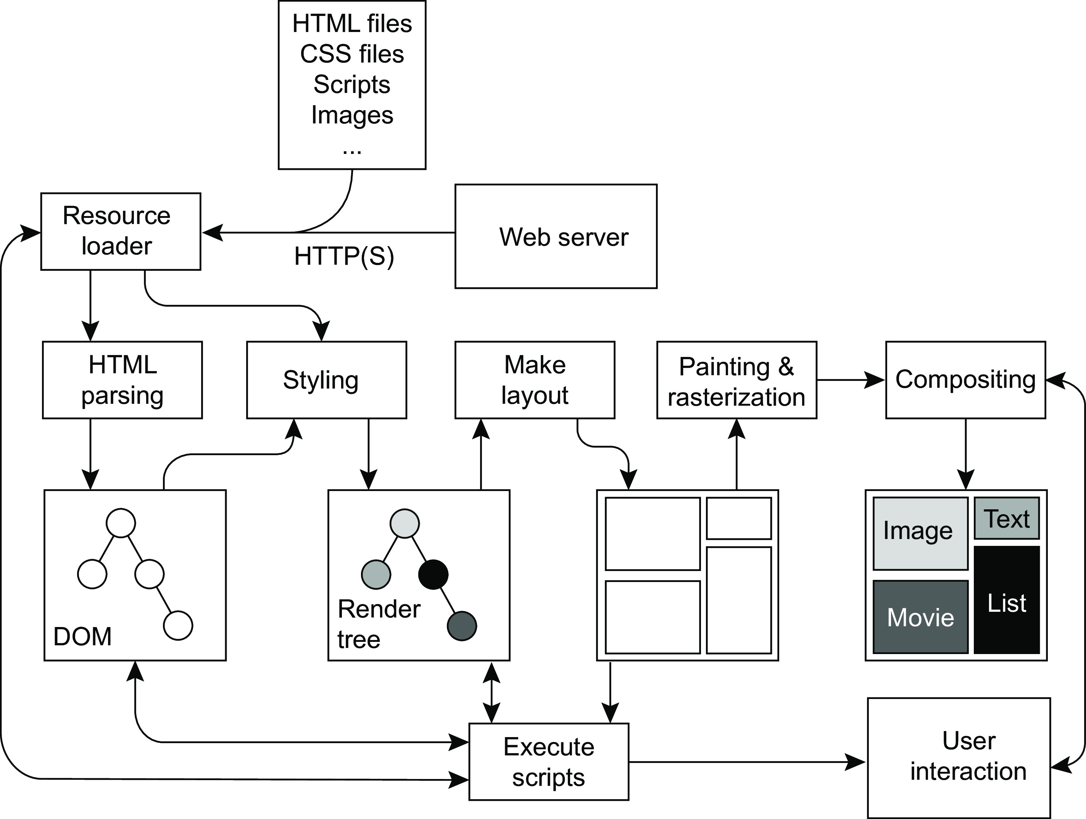
Processes
Clients
The anatomy of a Web browser
Virtual desktop environment

Slide 42
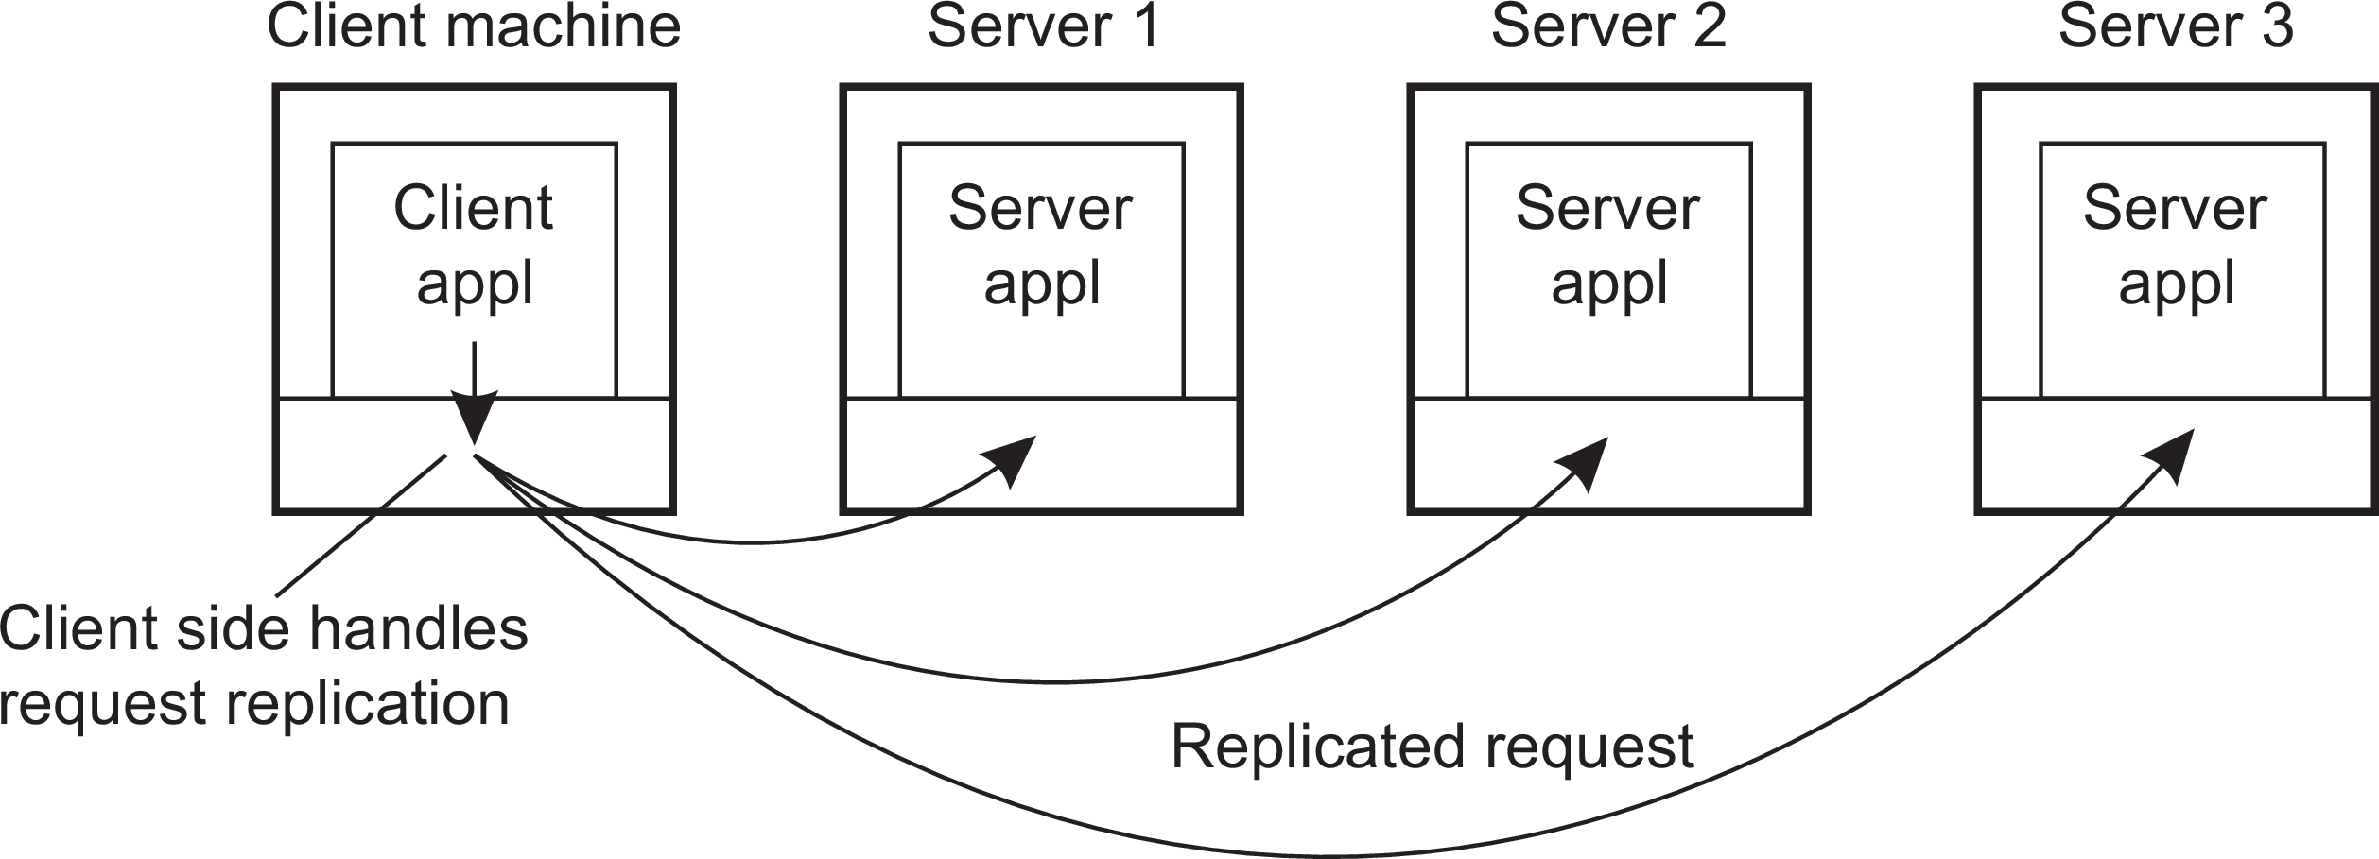
Processes
Clients
Client-side software
Generally tailored for distribution transparency
Access transparency: client-side stubs for RPCs
Location/migration transparency: let client-side software keep track of actual location
Replication transparency: multiple invocations handled by client stub:
Failure transparency: can often be placed only at client (we’re trying to mask server and communication failures).
Client-side software for distribution transparency

Slide 43
Processes
Servers
Servers: General organization
Basic model
A process implementing a specific service on behalf of a collection of clients. It waits for an incoming request from a client and subsequently ensures that the request is taken care of, after which it waits for the next incoming request.
General design issues

Slide 44
Processes
Servers
Servers: General organization
Basic model
A process implementing a specific service on behalf of a collection of clients. It waits for an incoming request from a client and subsequently ensures that the request is taken care of, after which it waits for the next incoming request.
Two basic types
Iterative server: Server handles the request before attending a next request.
Concurrent server: Uses a dispatcher, which picks up an incoming request that is then passed on to a separate thread/process.
Observation
Concurrent servers are the norm: they can easily handle multiple requests, notably in the presence of blocking operations (to disks or other servers).
General design issues

Slide 45
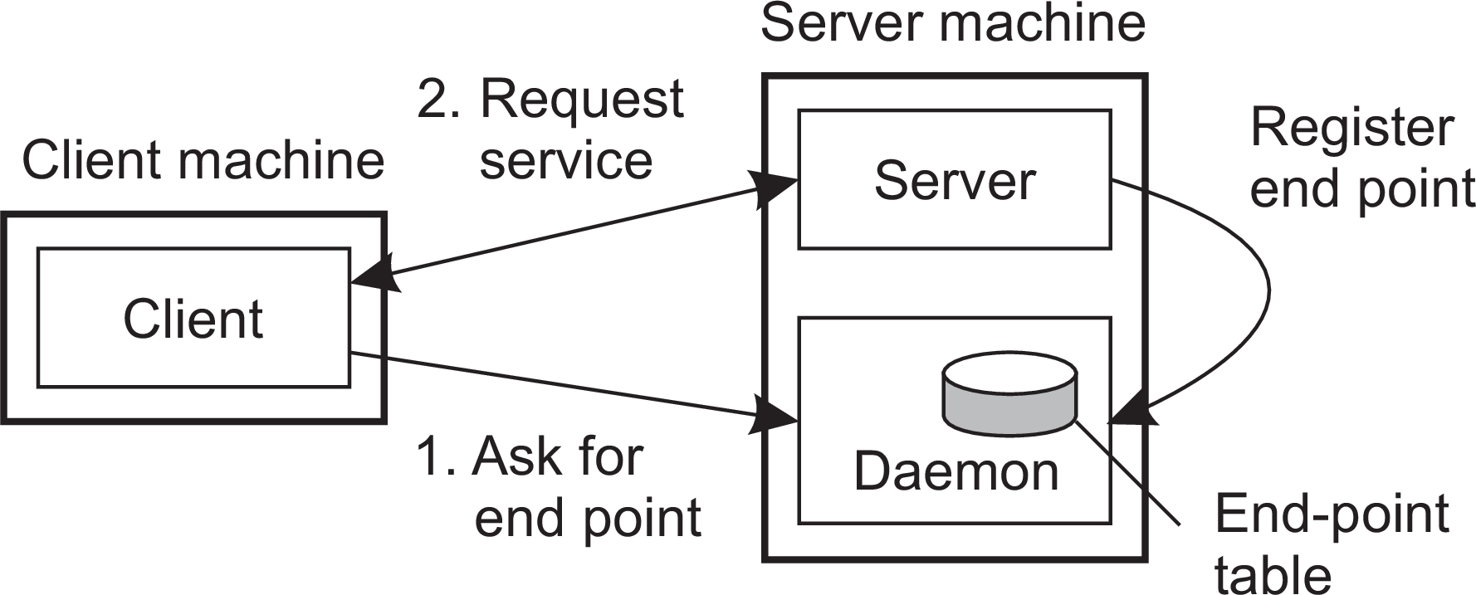
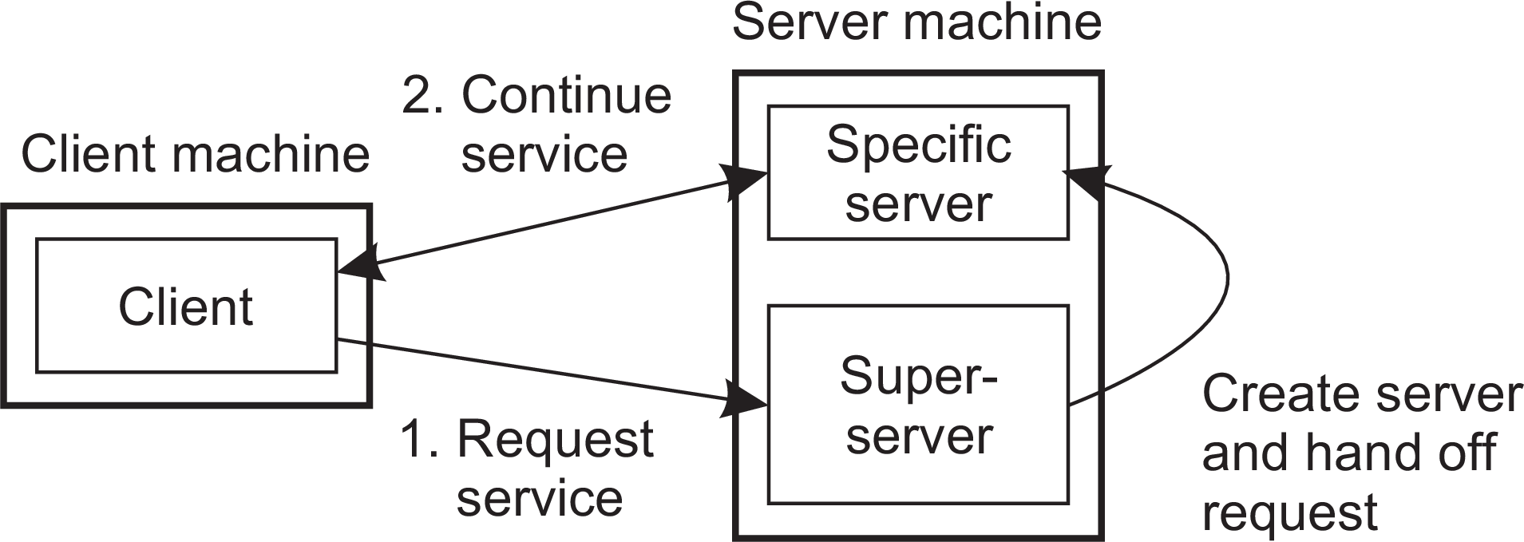
Processes
Servers
Contacting a server
Observation: most services are tied to a specific port
ftp-data | 20 | File Transfer [Default Data]
ftp | 21 | File Transfer [Control]
telnet | 23 | Telnet
smtp | 25 | Simple Mail Transfer
www | 80 | Web (HTTP)
Dynamically assigning an end point: two approaches
General design issues

Slide 46
Processes
Servers
Out-of-band communication
Issue
Is it possible to interrupt a server once it has accepted (or is in the process of accepting) a service request?
General design issues

Slide 47
Processes
Servers
Out-of-band communication
Issue
Is it possible to interrupt a server once it has accepted (or is in the process of accepting) a service request?
Solution 1: Use a separate port for urgent data
Server has a separate thread/process for urgent messages
Urgent message comes in ⇒ associated request is put on hold
Note: we require OS supports priority-based scheduling
General design issues

Slide 48
Processes
Servers
Out-of-band communication
Issue
Is it possible to interrupt a server once it has accepted (or is in the process of accepting) a service request?
Solution 1: Use a separate port for urgent data
Server has a separate thread/process for urgent messages
Urgent message comes in ⇒ associated request is put on hold
Note: we require OS supports priority-based scheduling
Solution 2: Use facilities of the transport layer
Example: TCP allows for urgent messages in same connection
Urgent messages can be caught using OS signaling techniques
General design issues

Slide 49
Processes
Servers
Servers and state
Stateless servers
Never keep accurate information about the status of a client after having handled a request:
Don’t record whether a file has been opened (simply close it again after access)
Don’t promise to invalidate a client’s cache
Don’t keep track of your clients
General design issues

Slide 50
Processes
Servers
Servers and state
Stateless servers
Never keep accurate information about the status of a client after having handled a request:
Don’t record whether a file has been opened (simply close it again after access)
Don’t promise to invalidate a client’s cache
Don’t keep track of your clients
Consequences
Clients and servers are completely independent
State inconsistencies due to client or server crashes are reduced
Possible loss of performance because, e.g., a server cannot anticipate client behavior (think of prefetching file blocks)
General design issues

Slide 51
Processes
Servers
Servers and state
Stateless servers
Never keep accurate information about the status of a client after having handled a request:
Don’t record whether a file has been opened (simply close it again after access)
Don’t promise to invalidate a client’s cache
Don’t keep track of your clients
Consequences
Clients and servers are completely independent
State inconsistencies due to client or server crashes are reduced
Possible loss of performance because, e.g., a server cannot anticipate client behavior (think of prefetching file blocks)
Question
Does connection-oriented communication fit into a stateless design?
General design issues

Slide 52
Processes
Servers
Servers and state
Stateful servers
Keeps track of the status of its clients:
Record that a file has been opened, so that prefetching can be done
Knows which data a client has cached, and allows clients to keep local copies of shared data
General design issues

Slide 53
Processes
Servers
Servers and state
Stateful servers
Keeps track of the status of its clients:
Record that a file has been opened, so that prefetching can be done
Knows which data a client has cached, and allows clients to keep local copies of shared data
Observation
The performance of stateful servers can be extremely high, provided clients are allowed to keep local copies. As it turns out, reliability is often not a major problem.
General design issues

Slide 54
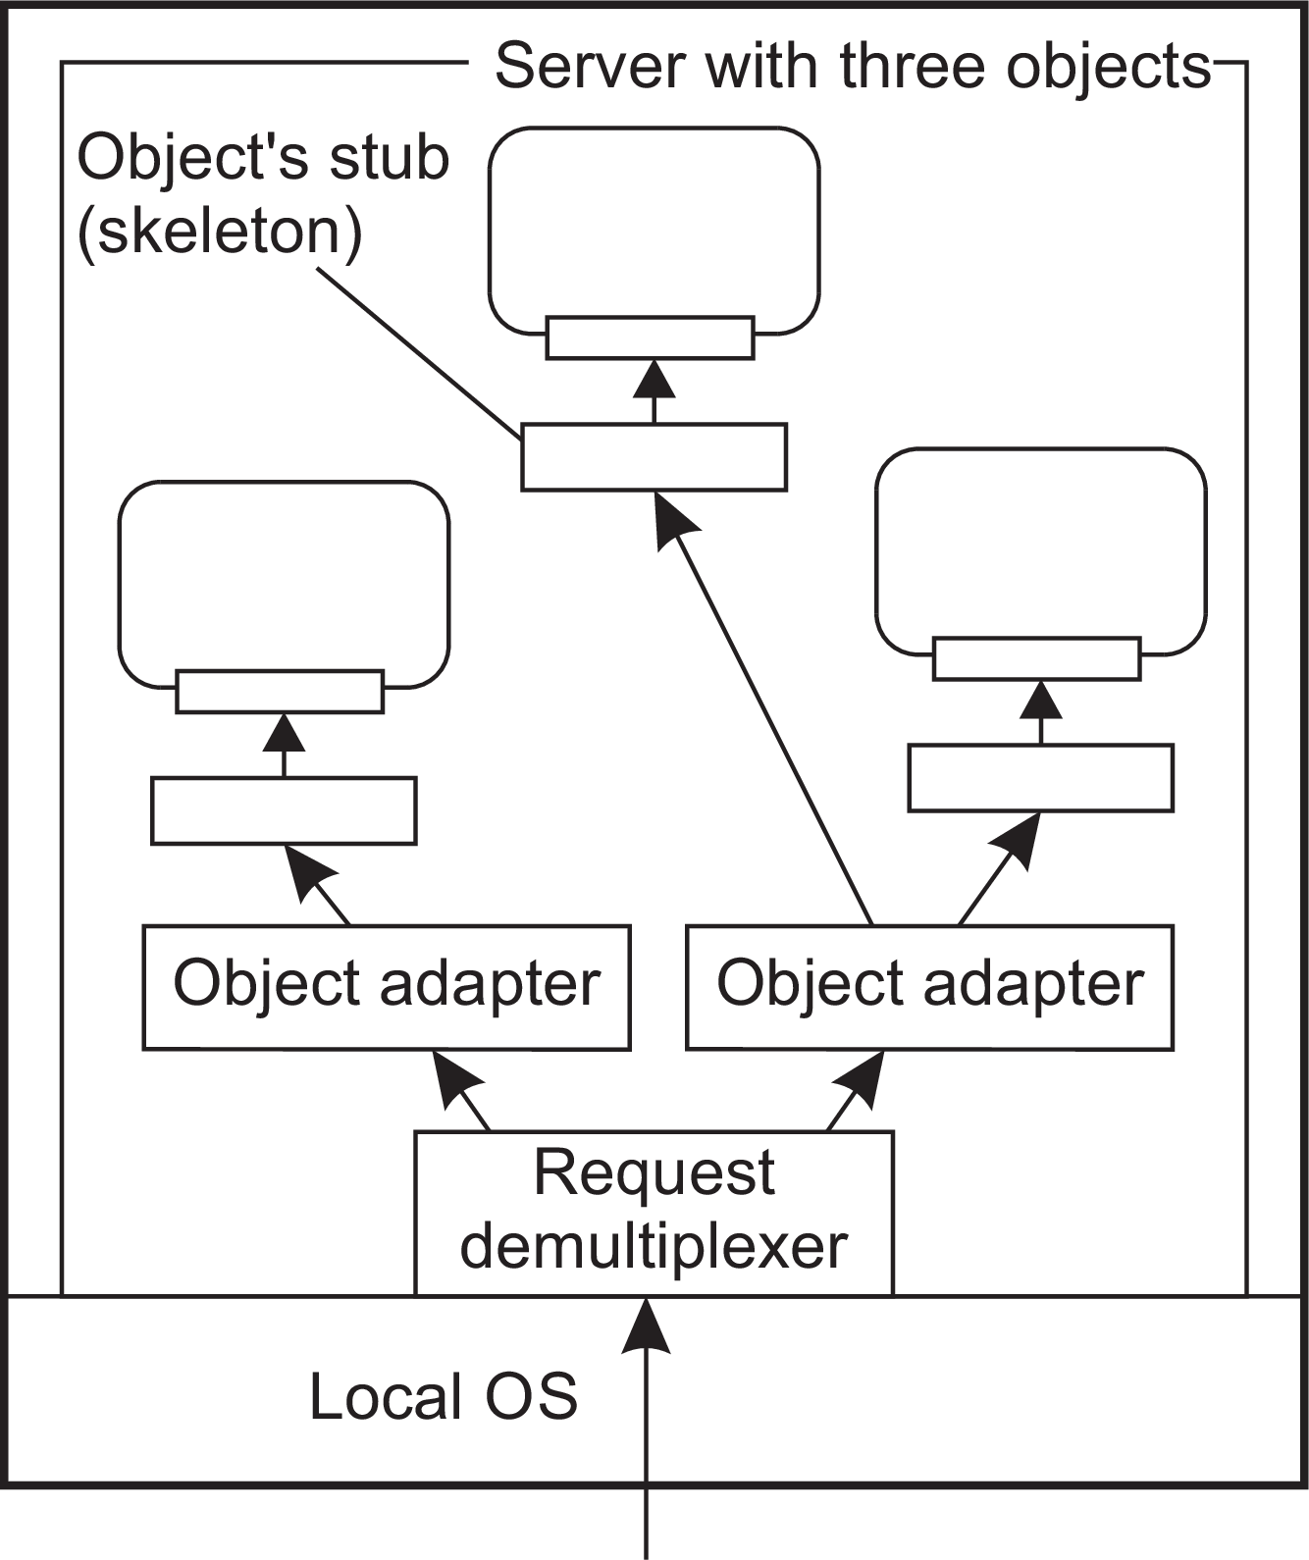
Processes
Servers
Object servers
Activation policy: which actions to take when an invocation request comes in:
Where are code and data of the object?
Which threading model to use?
Keep modified state of object, if any?
Object adapter: implements a specific activation policy
Object servers

Slide 55
Processes
Servers
Example: Ice runtime system – a server
1 import sys, Ice
2 import Demo
3
4 class PrinterI(Demo.Printer):
5
6
7
8
9
10
def init (self, t): self.t = t
def printString(self, s, current=None):
print(self.t, s)
11 communicator = Ice.initialize(sys.argv)
12
13 adapter = communicator.createObjectAdapterWithEndpoints("SimpleAdapter", "default -p 11000")
14 object1 = PrinterI("Object1 says:")
15 object2 = PrinterI("Object2 says:")
16 adapter.add(object1, communicator.stringToIdentity("SimplePrinter1"))
17 adapter.add(object2, communicator.stringToIdentity("SimplePrinter2"))
18 adapter.activate()
19
20 communicator.waitForShutdown()
Object servers

Slide 56
Processes
Servers
Example: Ice runtime system – a client
1 import sys, Ice
2 import Demo
3
4 communicator = Ice.initialize(sys.argv)
5
6 base1 = communicator.stringToProxy("SimplePrinter1:default -p 11000")
7 base2 = communicator.stringToProxy("SimplePrinter2:default -p 11000")
8 printer1 = Demo.PrinterPrx.checkedCast(base1)
9 printer2 = Demo.PrinterPrx.checkedCast(base2)
10 if (not printer1) or (not printer2):
11 raise RuntimeError("Invalid proxy")
12
13 printer1.printString("Hello World from printer1!")
14 printer2.printString("Hello World from printer2!")
15
16 communicator.waitForShutdown()
Object1 says: Hello World from printer1! Object2 says: Hello World from printer2!
Object servers

Slide 57
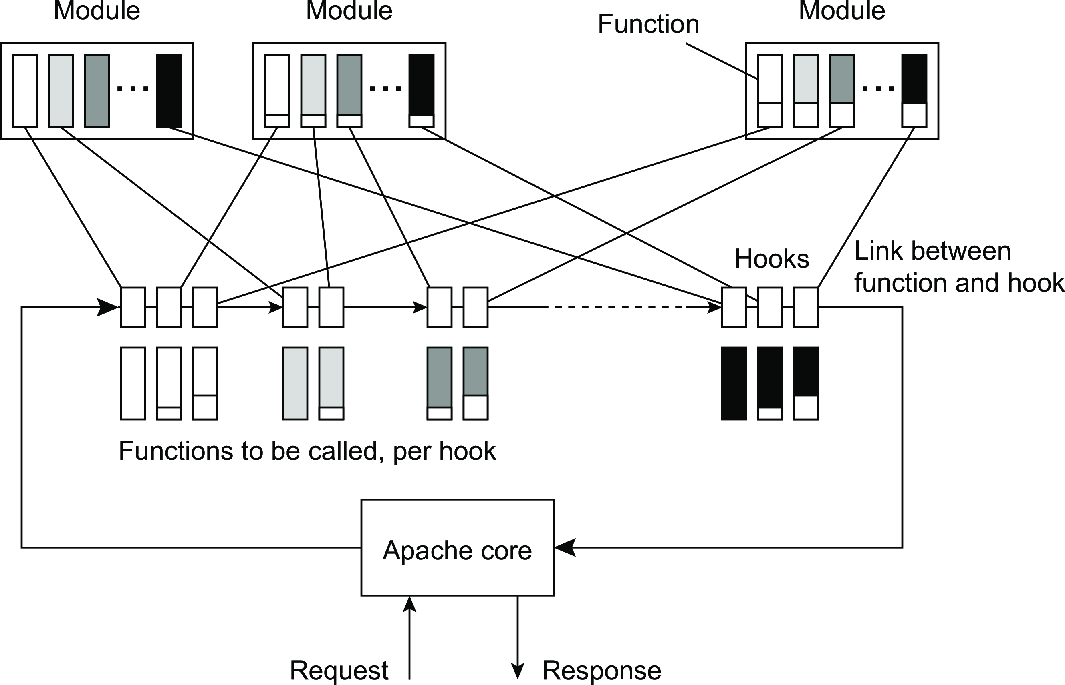
Processes
Servers
Example: the Apache Web server
Example: The Apache Web server

Slide 58
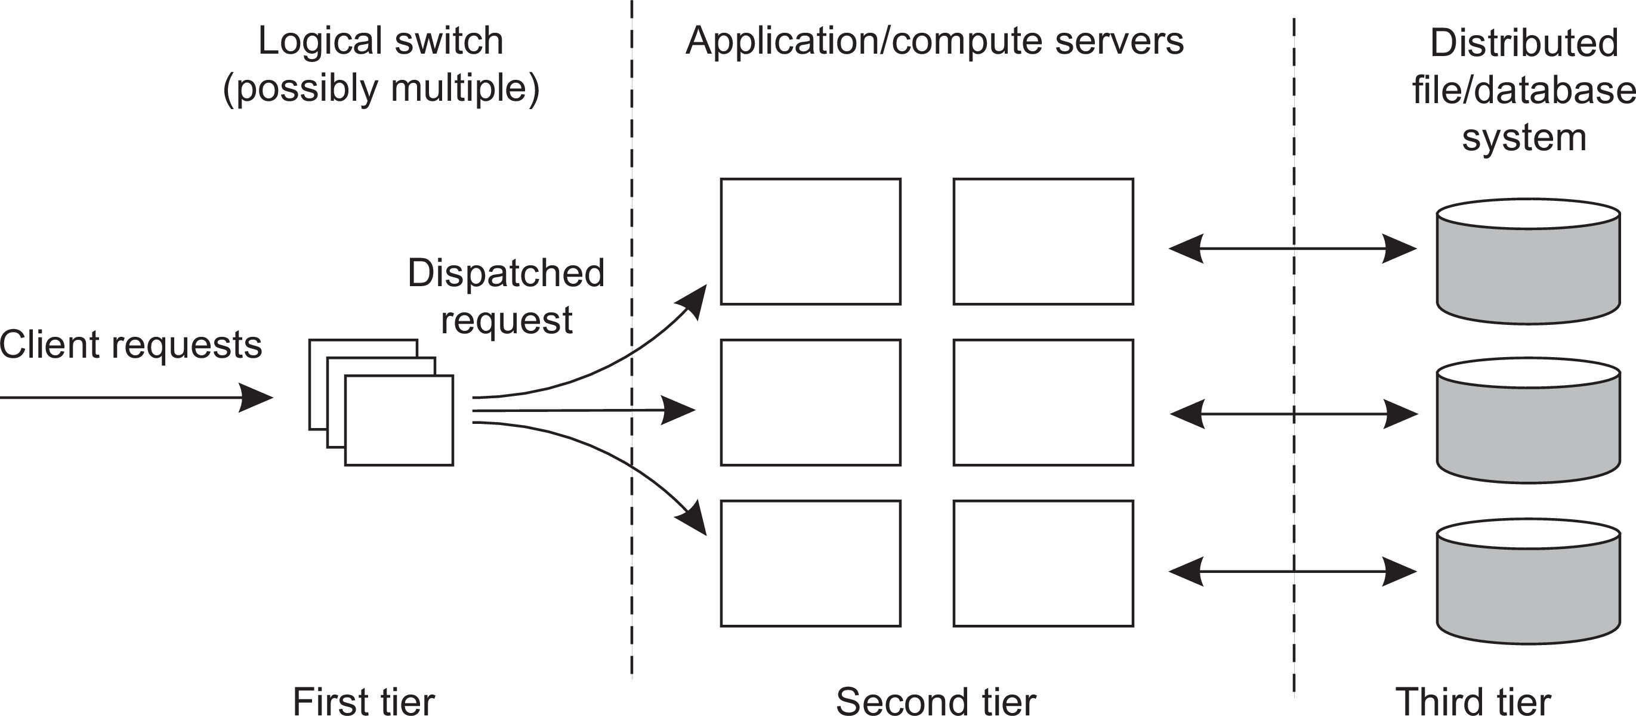
Processes
Servers
Three different tiers
Common organization
Crucial element
The first tier is generally responsible for passing requests to an appropriate server: request dispatching
Server clusters

Slide 59
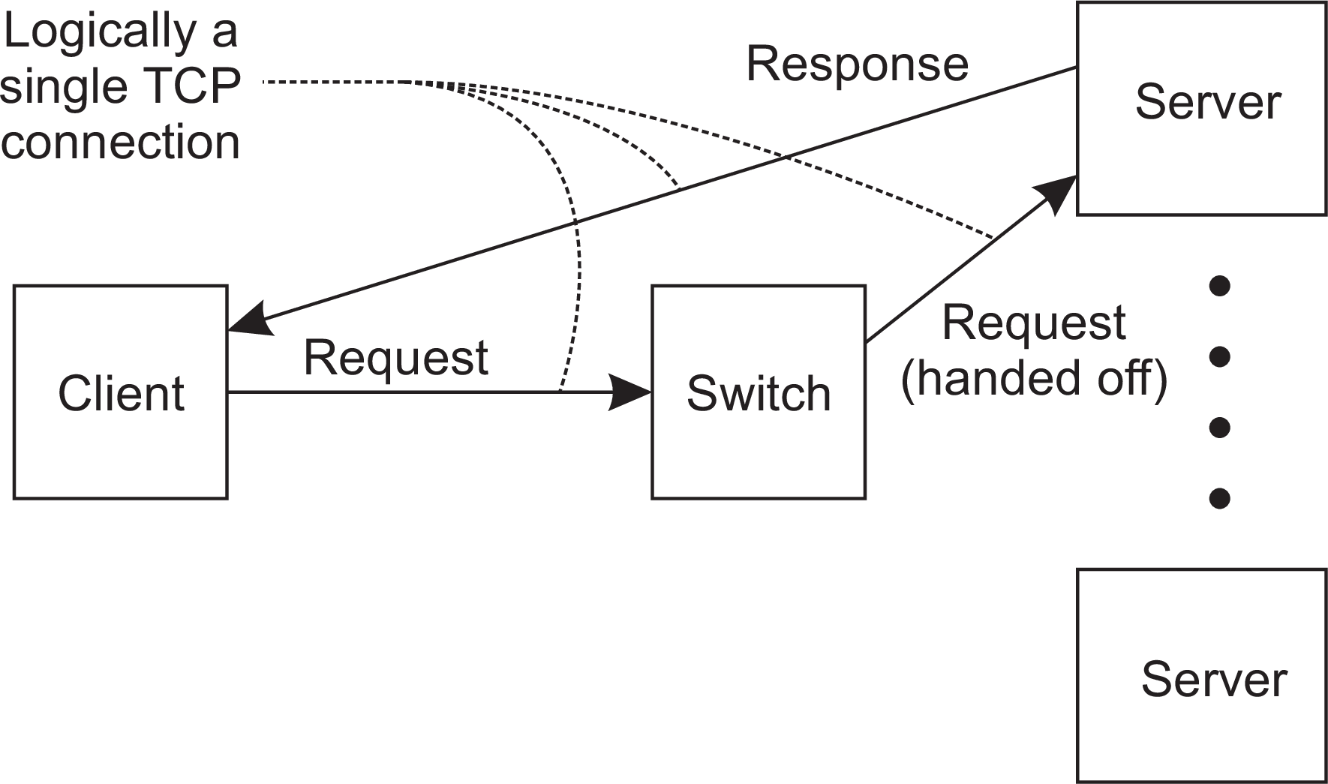
Processes
Servers
Request Handling
Observation
Having the first tier handle all communication from/to the cluster may lead to a bottleneck.
A solution: TCP handoff
Server clusters

Slide 60
Processes
Servers
When servers are spread across the Internet
Observation
Spreading servers across the Internet may introduce administrative problems. These can be largely circumvented by using data centers from a single cloud provider.
Request dispatching: if locality is important
Common approach: use DNS:
Client looks up specific service through DNS - client’s IP address is part of request
DNS server keeps track of replica servers for the requested service, and returns address of most local server.
Client transparency
To keep client unaware of distribution, let DNS resolver act on behalf of client. Problem is that the resolver may actually be far from local to the actual client.
Server clusters

Slide 61
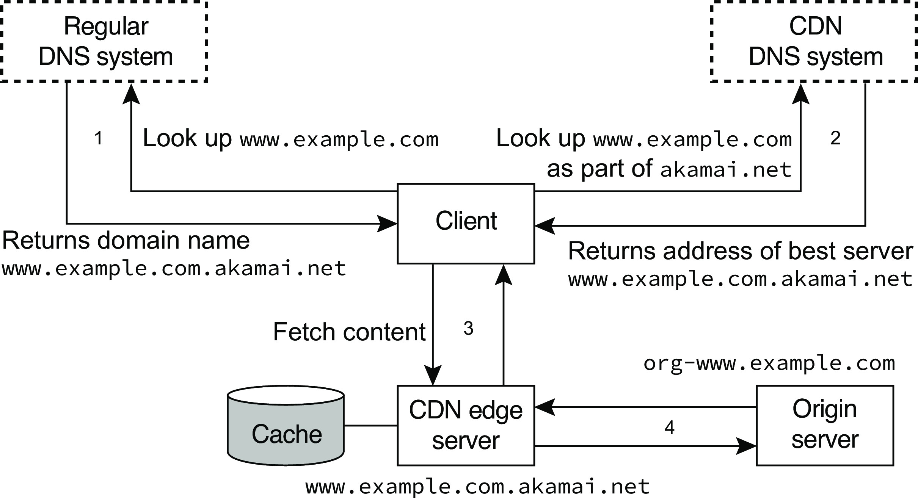
Processes
Servers
A simplified version of the Akamai CDN
Server clusters

Slide 62
Processes
Servers
A simplified version of the Akamai CDN
Important note
The cache is often sophisticated enough to hold more than just passive data. Much of the application code of the origin server can be moved to the cache as well.
Server clusters

Slide 63
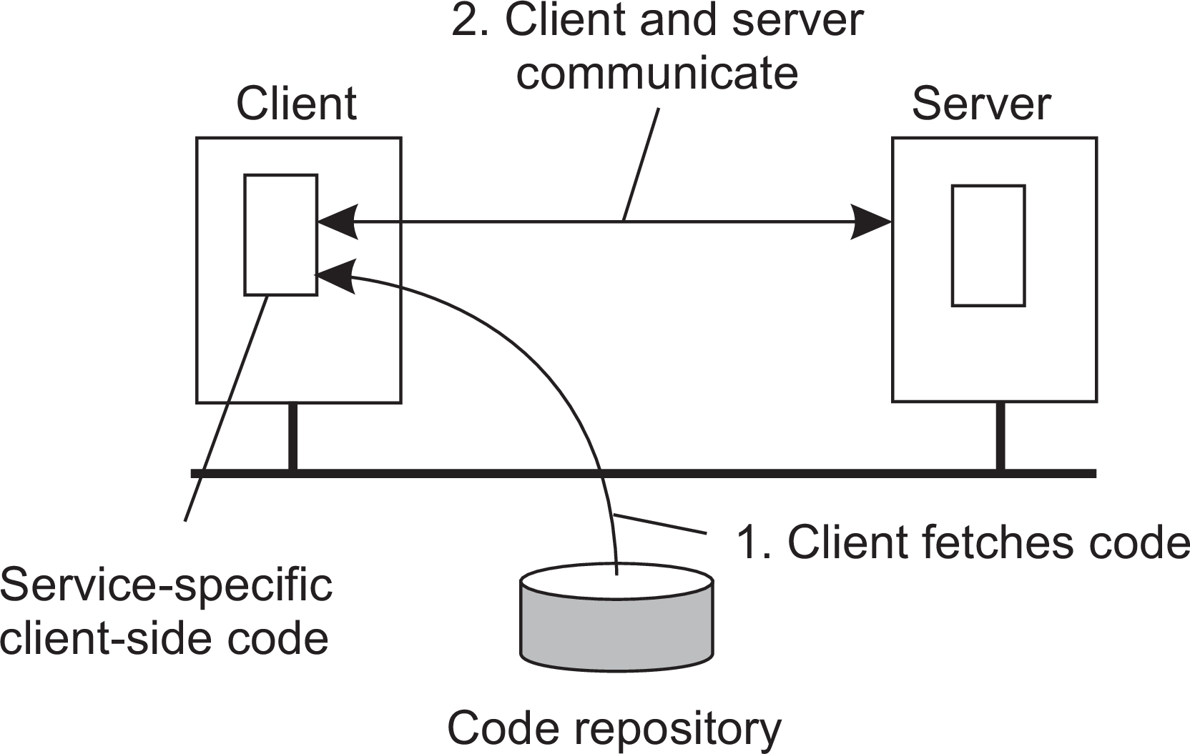
Processes
Code migration
Reasons to migrate code
Load distribution
Ensuring that servers in a data center are sufficiently loaded (e.g., to prevent waste of energy)
Minimizing communication by ensuring that computations are close to where the data is (think of mobile computing).
Flexibility: moving code to a client when needed
Avoids pre-installing software and increases dynamic configuration.
Reasons for migrating code

Slide 64
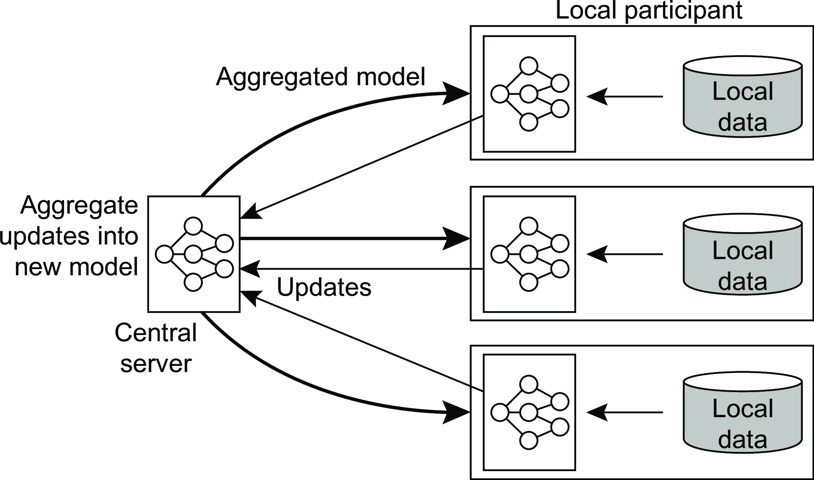
Reasons to migrate code
Processes Code migration
Privacy and security
In many cases, one cannot move data to another location, for whatever reason (often legal ones). Solution: move the code to the data.
Example: federated machine learning
Reasons for migrating code

Slide 65
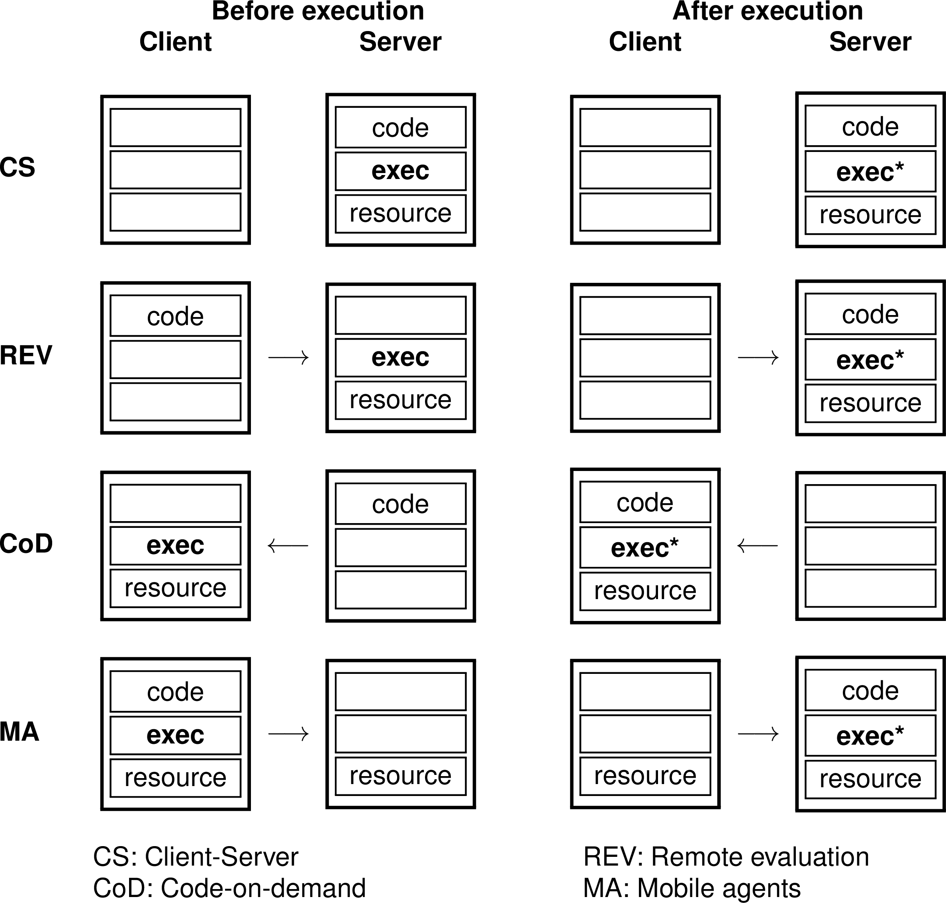
Processes
Code migration
Paradigms for code mobility
Models for code migration

Slide 66
Processes
Code migration
Strong and weak mobility
Object components
Code segment: contains the actual code
Data segment: contains the state
Execution state: contains context of thread executing the object’s code
Weak mobility: Move only code and data segment (and reboot execution)
Relatively simple, especially if code is portable
Distinguish code shipping (push) from code fetching (pull)
Strong mobility: Move component, including execution state
Migration: move entire object from one machine to the other
Cloning: start a clone, and set it in the same execution state.
Models for code migration

Slide 67
Migration in heterogeneous systems
Processes Code migration
Main problem
The target machine may not be suitable to execute the migrated code
The definition of process/thread/processor context is highly dependent on local hardware, operating system and runtime system
Only solution: abstract machine implemented on different platforms
Interpreted languages, effectively having their own VM
Virtual machine monitors
Observation
As containers are directly dependent on the underlying operating system, their migration in heterogeneous environments is far from trivial, to simply impractical, just as process migration is.
Migration in heterogeneous systems

Slide 68
Migrating a virtual machine
Processes Code migration
Migrating images: three alternatives
Pushing memory pages to the new machine and resending the ones that are later modified during the migration process.
Stopping the current virtual machine; migrate memory, and start the new virtual machine.
Letting the new virtual machine pull in new pages as needed: processes start on the new virtual machine immediately and copy memory pages on demand.
Migration in heterogeneous systems

Slide 69
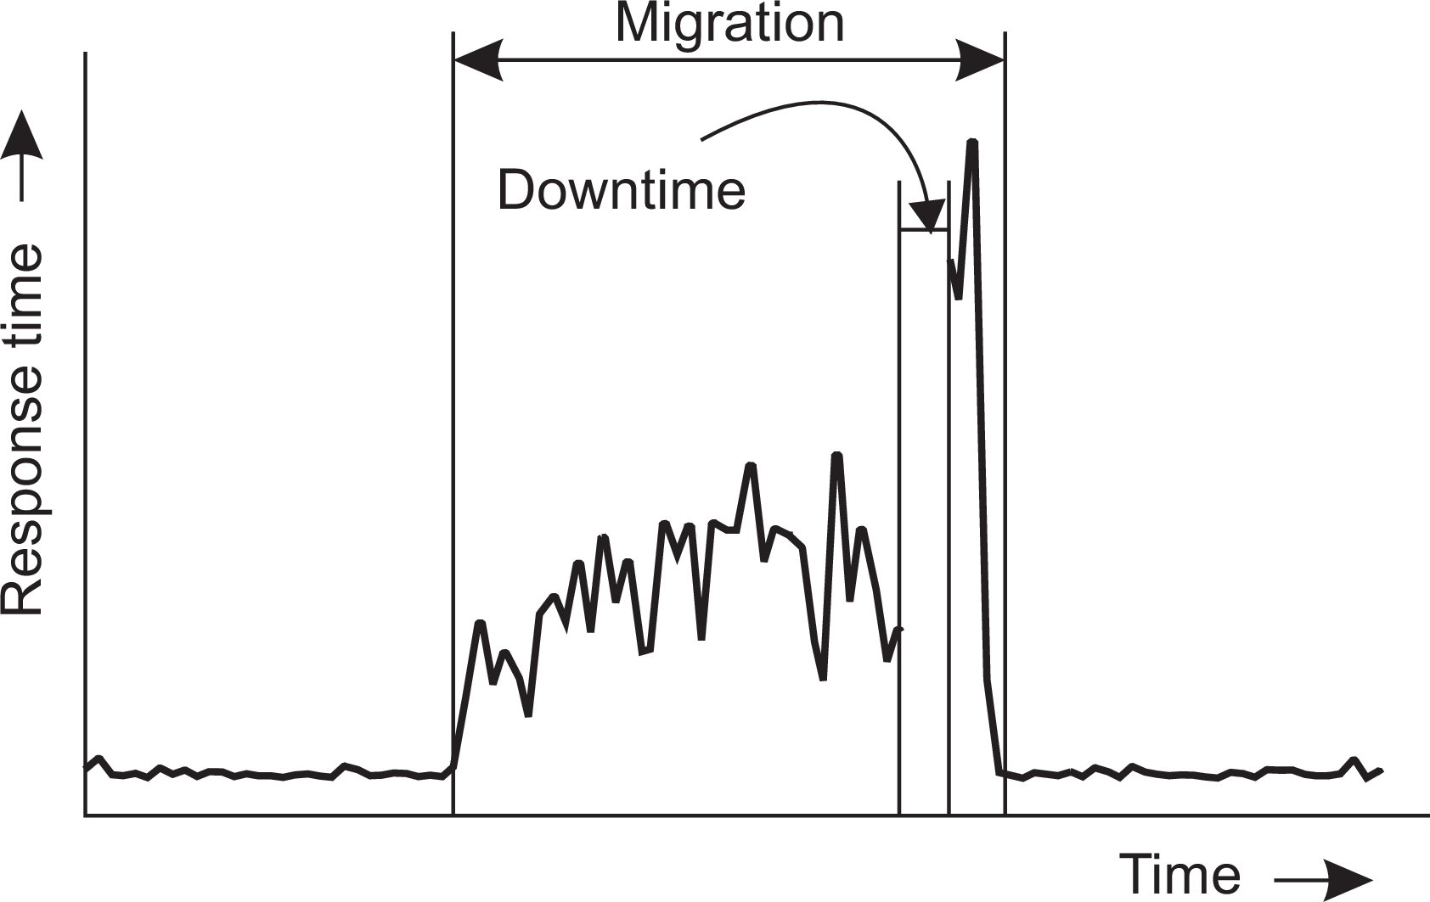
Processes
Code migration
Performance of migrating virtual machines
Problem
A complete migration may actually take tens of seconds. We also need to realize that during the migration, a service will be completely unavailable for multiple seconds.
Measurements regarding response times during VM migration
Migration in heterogeneous systems

